Slide 1

Does the rise of Winery growth influence Regional dynamics?
Presented by: Eli, Luis, Raquel

Slide 2
Initial considerations
Theory
Winery presence in the US has increased by 58% over the past 10 years. Where has that growth been strong? What impact has it had on local economy, health, crash and population?
Data Limitations
While a broad reach of data is available, limits to free sets at a city/county level across the information being sought proved less available resulting in pulling back to a state level analysis. Similarly, years of available data were not always consistent and restricted some comparisons as a result.
Outcomes
Given time constraints we ultimately focused on 5 of the most well-known wine states for our analysis. While there are some correlations, we found that items we assumed might have stronger links were not directly relevant and others may be more influenced by additional factors we did not have time to review during this project.

Slide 3
Winery growth and consumption

Slide 4
Tourism economic impacts

Slide 5
Price Parity/affordability

Slide 6
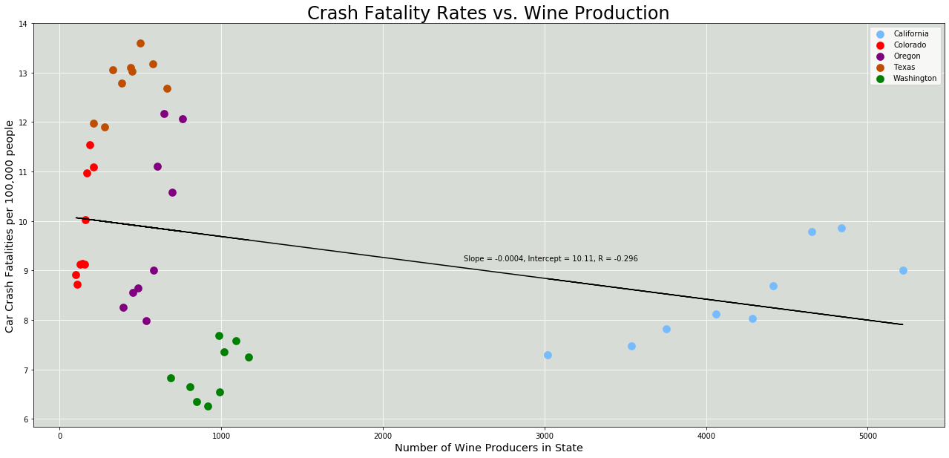
Crash FATALITY RATES VS WINE PRODUCTION

Slide 7
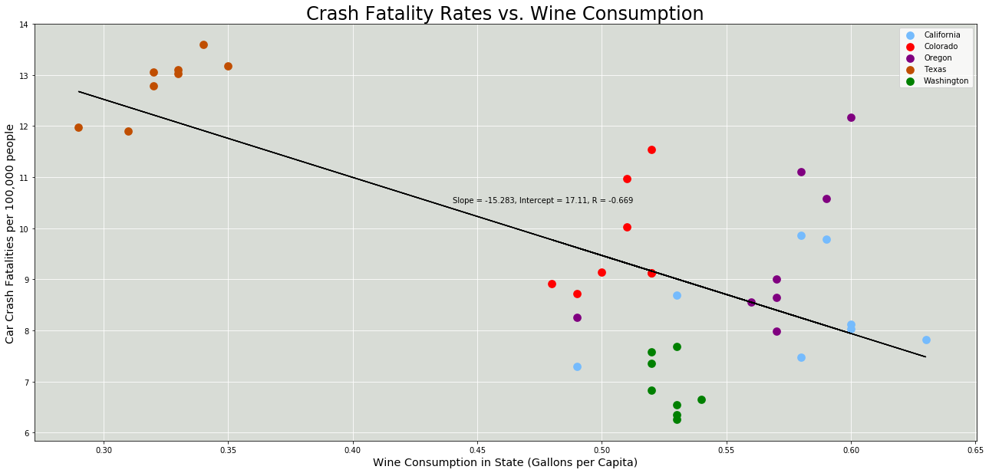
Crash FATALITY RATES VS WINE CONSUMPTION

Slide 8
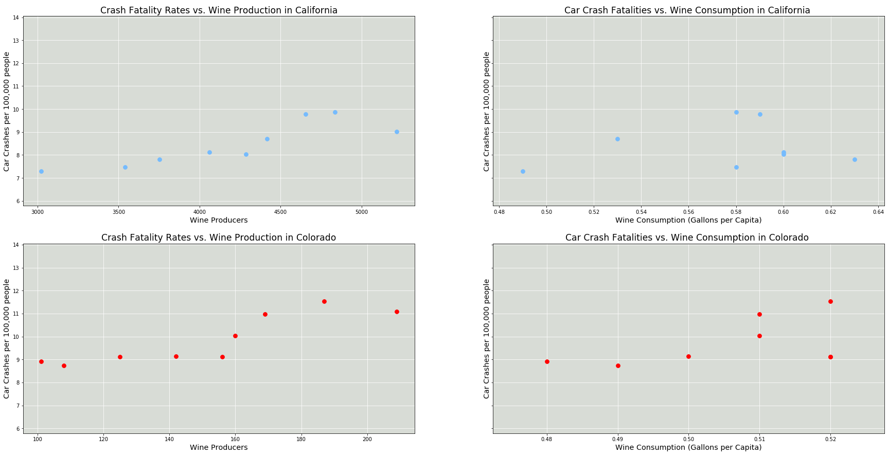
Crash FATALITY RATES – CA & CO

Slide 9
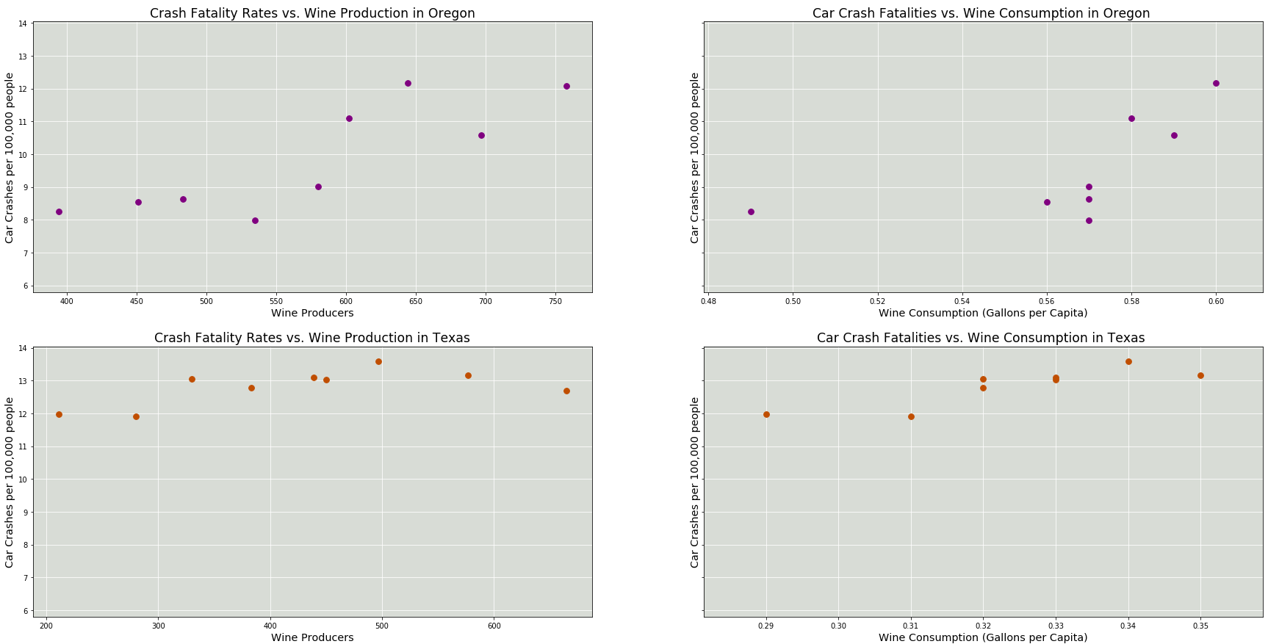
Crash FATALITY RATES – OR & TX

Slide 10
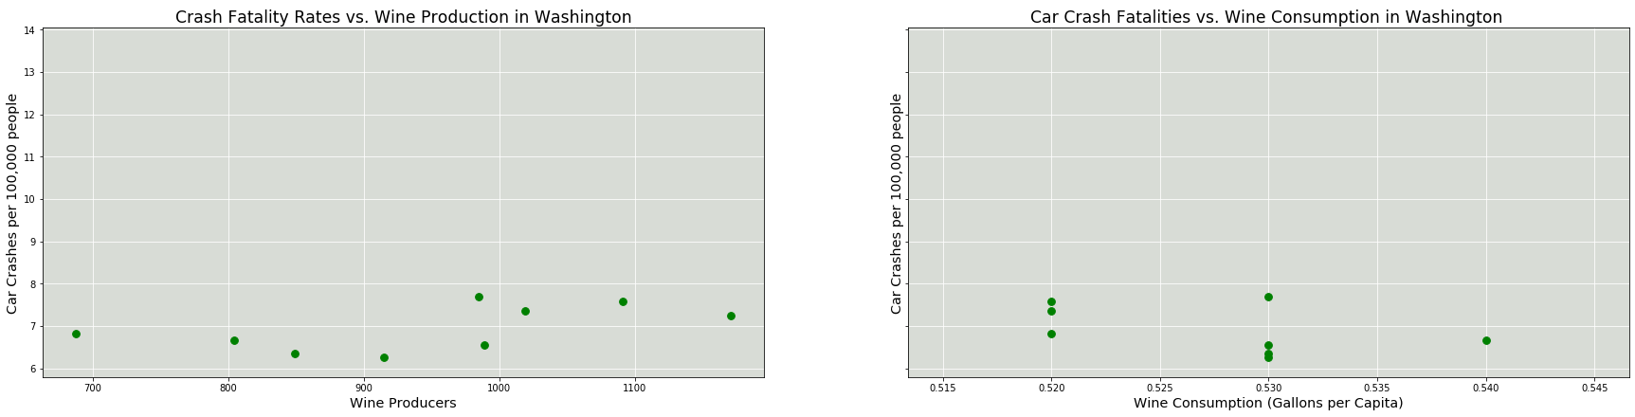
Crash FATALITY RATES – WA

Slide 11
Health implications

Slide 12
summary

Slide 13
Appendix & references

Slide 14
references
Wine & Vines
US Census Bureau
Department of the Treasury, Alcohol, Tobacco Tax and Trade Bureau
National Institute on Alcohol Abuse and Alcoholism
Bureau of Economic Analysis
Centers for Disease Control and Prevention
Kaiser Family Foundation
National Low Income Housing Coalition
National Highway Traffic Safety Administration (API)
Everyvine
VinePair
The preceding analysis was based on data obtained from these sources.
Unless noted, data files were obtained as csv files.

Slide 15
Appendix: Next Steps

Slide 16
Appendix: Unused Charts

